Slide 1




Deep Learning-Based PET Image Correction Toward Quantitative Imaging
Presenter: Sama Shahpouri
Study : Data Science for Life Science
Institute: Hanze University of Applied Sciences, Institute of Life Science & Technology
Supervisors: Dr. Isaac Shiri, Dr. Dave Landers, Dr. Gijs van derhot
28/08/2024

Slide 2
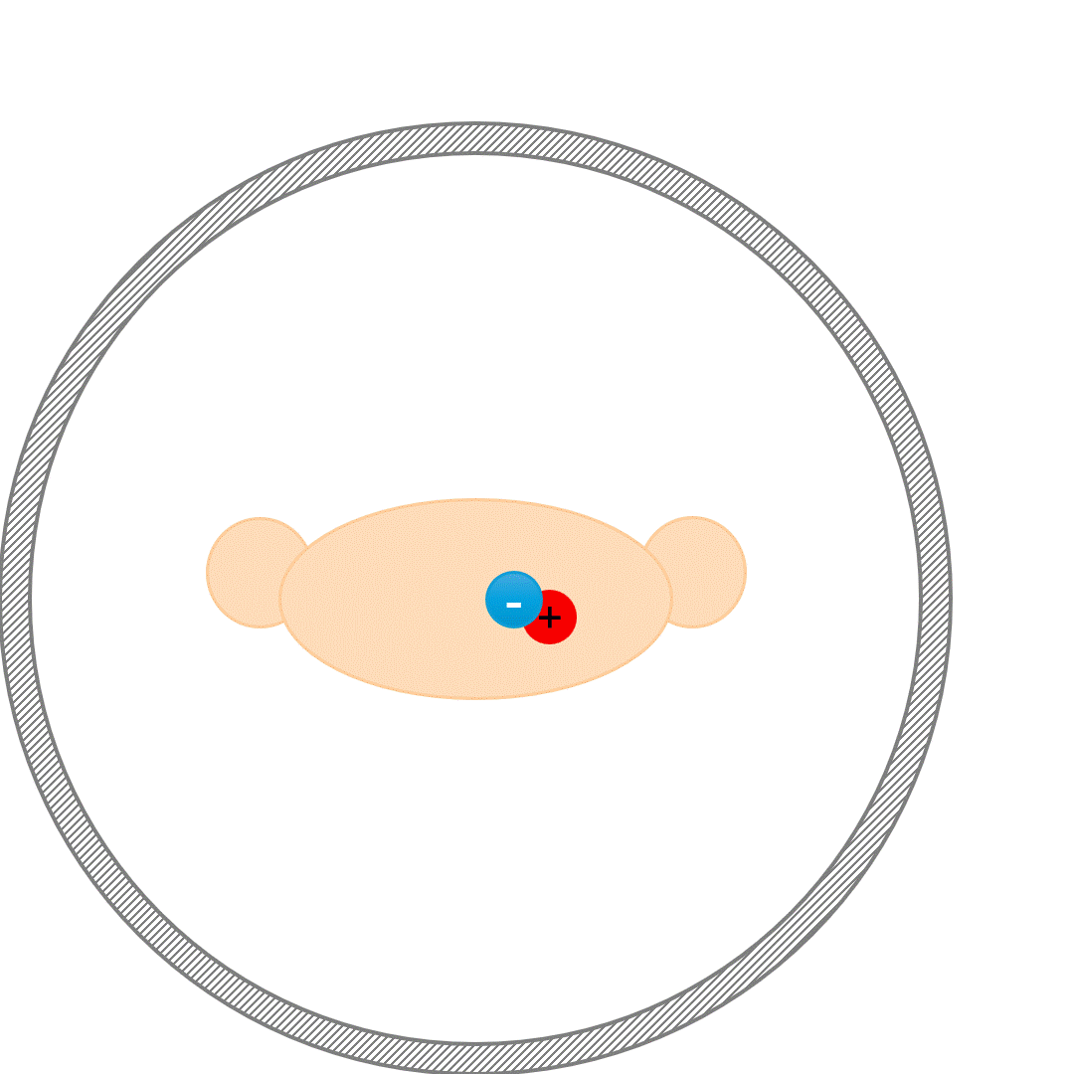
PET Attenuation and Scatter Correction (ASC)
Attenuation correction (AC) of annihilation photons along lines of response (LOR) in the patient body is another critical step
Scatter correction (SC) of Compton scattered photons, which can result in mis-allocation of the annihilated photons, is crucial
Notes:
Positron Emission Tomography (PET) is the gold standard of molecular imaging modalities and widely use around the world for Diagnosis and treatment follow-up.
each positron emits from the radiotracer inside the body, interact with an electron of the surrounding tissue area, and they produce 2 gamma rays.
if these 2 gamma-rays would detected in a short period of time and in the exact opposite that is a true coincidence and we have a correct line of responce can registered a true event contributing to create a PET image. But because of Compton scattering sometimes we have scatter and random events.
Two major factors that affect the quality of PET images are these attenuation and scatter phenomenan.
Attenuation happens when the energy of gamma-ray photons decreass as they pass through the body tissue.
Different tissues density attenuate photons to the different directions.
they can lead to inaccuracies in the representation of tracer distribution.
So we need a solution for compensating attenuation and correcting scatter events.
True Coincidence
One annihilation
Straight path photons
Scatter Coincidence
One annihilation
Photons scatter
Artifactual measured LOR

Slide 3
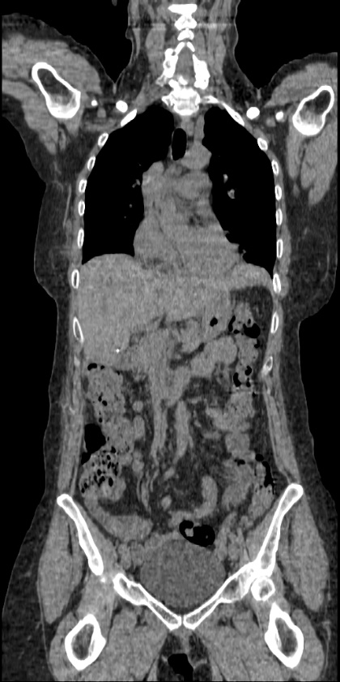
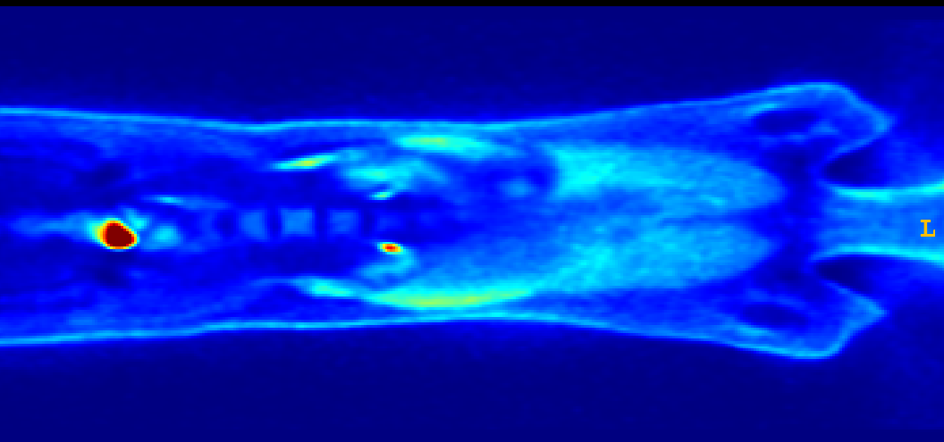
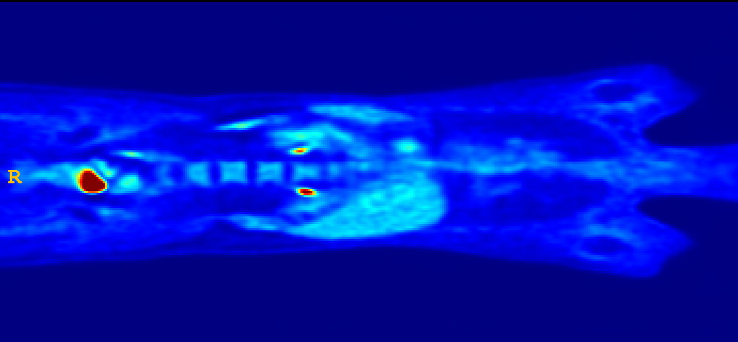
Effects of Attenuation Scatter Correction
Reduced mediastinal
uptake
'Hot' lungs
Non-uniform liver
Enhanced skin uptake
Non-Attenuation Corrected image (NAC) Model-based Attenuation-scatter corrected image(MAC) CT image
Notes:
Around 50 percent of the photons detected and used to create images have been scattered at least once along their path. And here you can see some important effect of these scattered photons on the image: Hot lung, non uniform liver and enhanced skin uptake.
So ASC is the most important necessity must be done for the pet so image will be visually interpretable and quantitatively accurate .

Slide 4
Data flow in a PET/CT scanner [1]
CT Image
X-ray acquisition
Anatomical (CT) Reconstruction
Smooth to PET Resolution
Translate CT to PET Energy (511 keV)
PET Image
PET Emission Acquisition
Attenuation/Scatter Correct PET Emission Data
Functional (PET) Reconstruction
Notes:
Using the CT attenuation map is One of the regular way of doing these corrections. There are of course other methods like MRI, but today we would have just our attention to the CT. Here this is a simple fellow chart of how the ASC is done using anatomical information comes from CT scan.

Slide 5
Challenges in ASC using CT info
☢️Radiation Exposure
🚫Limited Availability
💰Cost and Complexity
💉Contrast Agent Issues
🩻 Artifacts
Notes:
But We have some limitation in using CT:
As CT scan expose patients, this can increase cancer risk over time.
Not all centers have access to CT devise
If we have to use contrast agent for diagnosis, using that ct is dificault and need more ???
Any misalignment or between CT and Pet scans can cause artifacts.

Slide 6
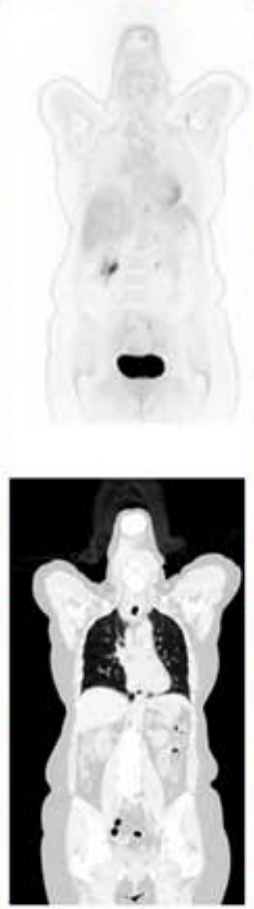
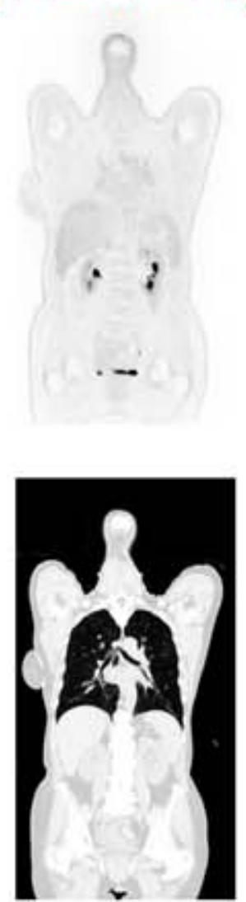
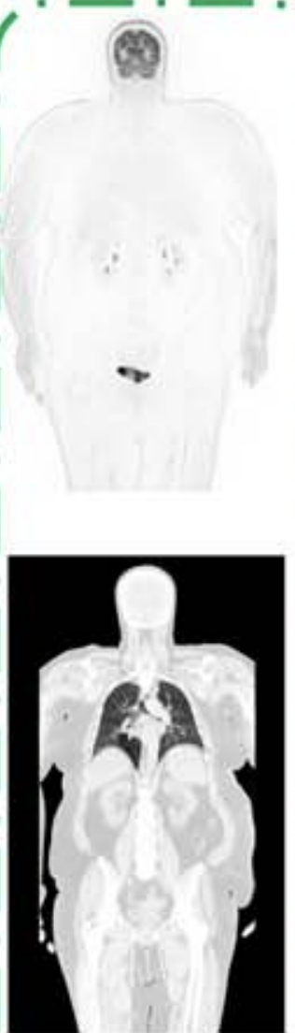
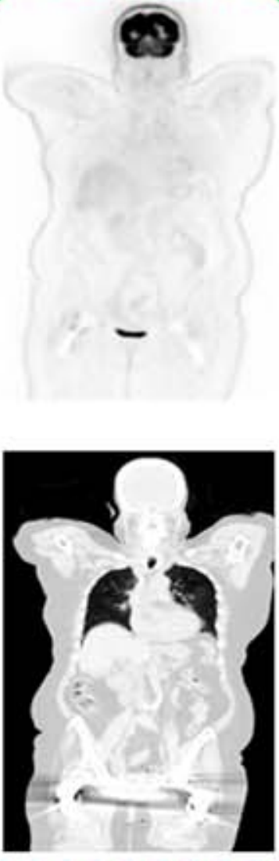
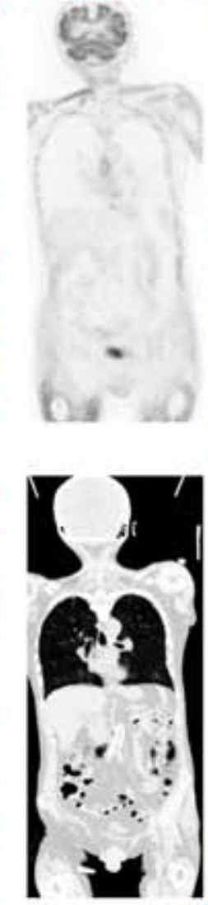
Challenges in ASC using CT info
Halo Motion Truncation Metal Mismatch
[1] Shiri, Clin Nucl Med. 2023
Notes:
Typical artifacts that might occur in PET imaging is showing here
Some Artifacts related to tracer distribution halo-artifact
Some linked to the association between PET and CT/MR images (eg, mismatch, misregistration, and motion artifacts in different regions),
and metals, and truncation artifacts Presence of metal implants can cause streak artifacts in CT images, affecting on PET images
Different field of View between PET and CT can cause Truncation artifacts in overweight cases or arm down

Slide 7
AI is starting to change medical imaging, for real
[2] McMillan, PET Clinic, 2021
Notes:
Various DL-based attenuation scatter correction (DL-ASC) methods have been developed for PET imaging. These include indirect approaches that generate attenuation maps from MRI or CT images.
Various DL-based attenuation scatter correction methods have been developed for PET imaging. These include indirect approaches that generate attenuation maps from MRI or CT images. Direct DL-ASC methods bypass traditional methods by making ASC PET images directly from NAC images. This was first used in brain PET imaging and then tested in ¹⁸F-FDG PET studies
A significant challenge arises with the low tracer activity and the extensive positron range of ⁶⁸Ga-labelled pharmaceuticals, which generally produce lower-quality images compared to ¹⁸F-labelled compounds
Now, it's time to integrate AI-based ASC methods into clinical workflows. Each center have slightly different protocols for imaging the same disease, and the characteristics of medical imaging devices vary from center to center. Not all centers have a dedicated AI team either.

Slide 8
Research Objective
✔️ Address direct ASC of PET images without CT anatomical data
✔️ Create a universal model applicable to different radiotracers and scanners ✔️ Evaluate model performance in artifact removal across a multi-center dataset
Notes:
The main aim of this study is to address the direct ASC of PET images and evaluate its performance in removing image artifacts using the multicenter dataset. We used our approach to estimate and compare the performance of models using both strategies within different radiotracers and scanners

Slide 9
Materials and Methods

Slide 10
Workflow of A CT-less deep learning network
PET raw data
Direct Method
CT images
Recon without AC & SC
Recon with AC & SC
Recon : reconstruction;
AC : attenuation correction,
SC : scatter correction,
NAC : non-corrected PET,
MAC : CT-Measured attenuation/scatter corrected,
DL PET : deep learning–corrected PET,
NAC (Input)
MAC (Target)
Model Training
DL PET
[3] Guo, Nat Commun. 2022
Notes:
A simple workflow of our work is : we used reconstructed pet images without applying any correction as input of a neural network. And we used a ct based corrected version of imput images as our target. From now on we named out imput nac and the target of the model or rather ground truth as mac.

Slide 11
Workflow of A CT-less deep learning network
PET raw data
Semi-Direct Method
CT images
Recon without AC & SC
Recon with AC & SC
NAC (Input)
ADCM (Target)
Anatomy-Dependent Correction Maps
Radiotracer-Dependent textures
Model Training
DL PET
[3] Guo, Nat Commun. 2022
Notes:
A recent article proposed an idea for overcoming the issue of different radiotracer distributions in the body.
every MAC image contain both anatomical information and radiotracer distribution information,
So if we just train our network on the anatomy-dependent part, we can get a model which is undependent to the tracer distribution and it might work for all radiotracer pattern.

Slide 12
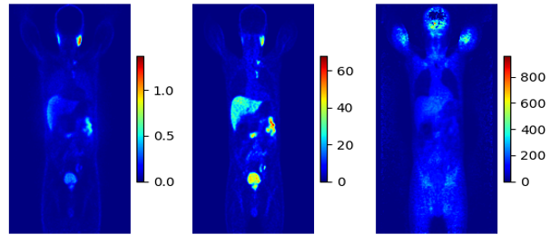
Sample of Input and Ground truths of the network
NAC MAC ADCM
Notes:
Maximum Intensity Projection

Slide 13
⁶⁸Ga PET/CT Dataset
Center | No | Train | Validation | Test | Scanner | Reconstruction | Matrix size × Z*
Center 1 | 56 | 43 | 11 | 2 | Siemens Biograph 6 | 3D-OSEM | 168 × 168
Center 2 | 31 | 25 | 4 | 2 | GE Discovery IQ | 3D-OSEM | 192 × 192
Center 3 | 45 | 35 | 8 | 2 | Siemens mCT | 3D-OSEM | 200 × 200
Center 4 | 40 | 28 | 10 | 2 | Siemens Biograph 6 | 3D-OSEM | 168 × 168
External Center | 12 | - | - | 12 | Siemens Horizon | PSF+TOF+3D-OSEM | 180 × 180
Total (%) | 184 | 131 (71%) | 33 (18%) | 20 (11%) | - | - | -
[1] Shiri, Clin Nucl Med, 2023
Notes:
A group of 184 patient selected from a cohort of 1000 patients 68Ga-PSMA PET/CT imaging across five centers.
This table shows acquisituin and reconstruction parameters of each center.
We excluded center 5 from the training and validation, as external test set, and the rest of 4 data wes stertified.

Slide 14
¹⁸F-FDG Dataset
Center | No | Train | Validation | Test | Scanner | Reconstruction | Matrix size × Z*
Center 6 | 55 | 39 | 6 | 11 | Siemens Biograph 6 | 3D-OSEM | 168 × 168
Center 7 | 43 | 23 | 9 | 10 | GE Discovery IQ | 3D-OSEM | 192 × 192
Total | 98 | 62 | 15 | 21 | - | - | -
[4] Shiri, Eur J Nucl Med Mol Imaging. 2023
Notes:
A total of 98 clean and artifact-free images from two different centers were selected.
As our cross-tracer dataset. 20% of data was selected for test and 65% and 15% were selected for tuning and validation respectively.

Slide 15
Artifact dataset
190 patients ¹⁸Ga PSMA PET/CT Mostly Motion and Halo artifacts

Slide 16
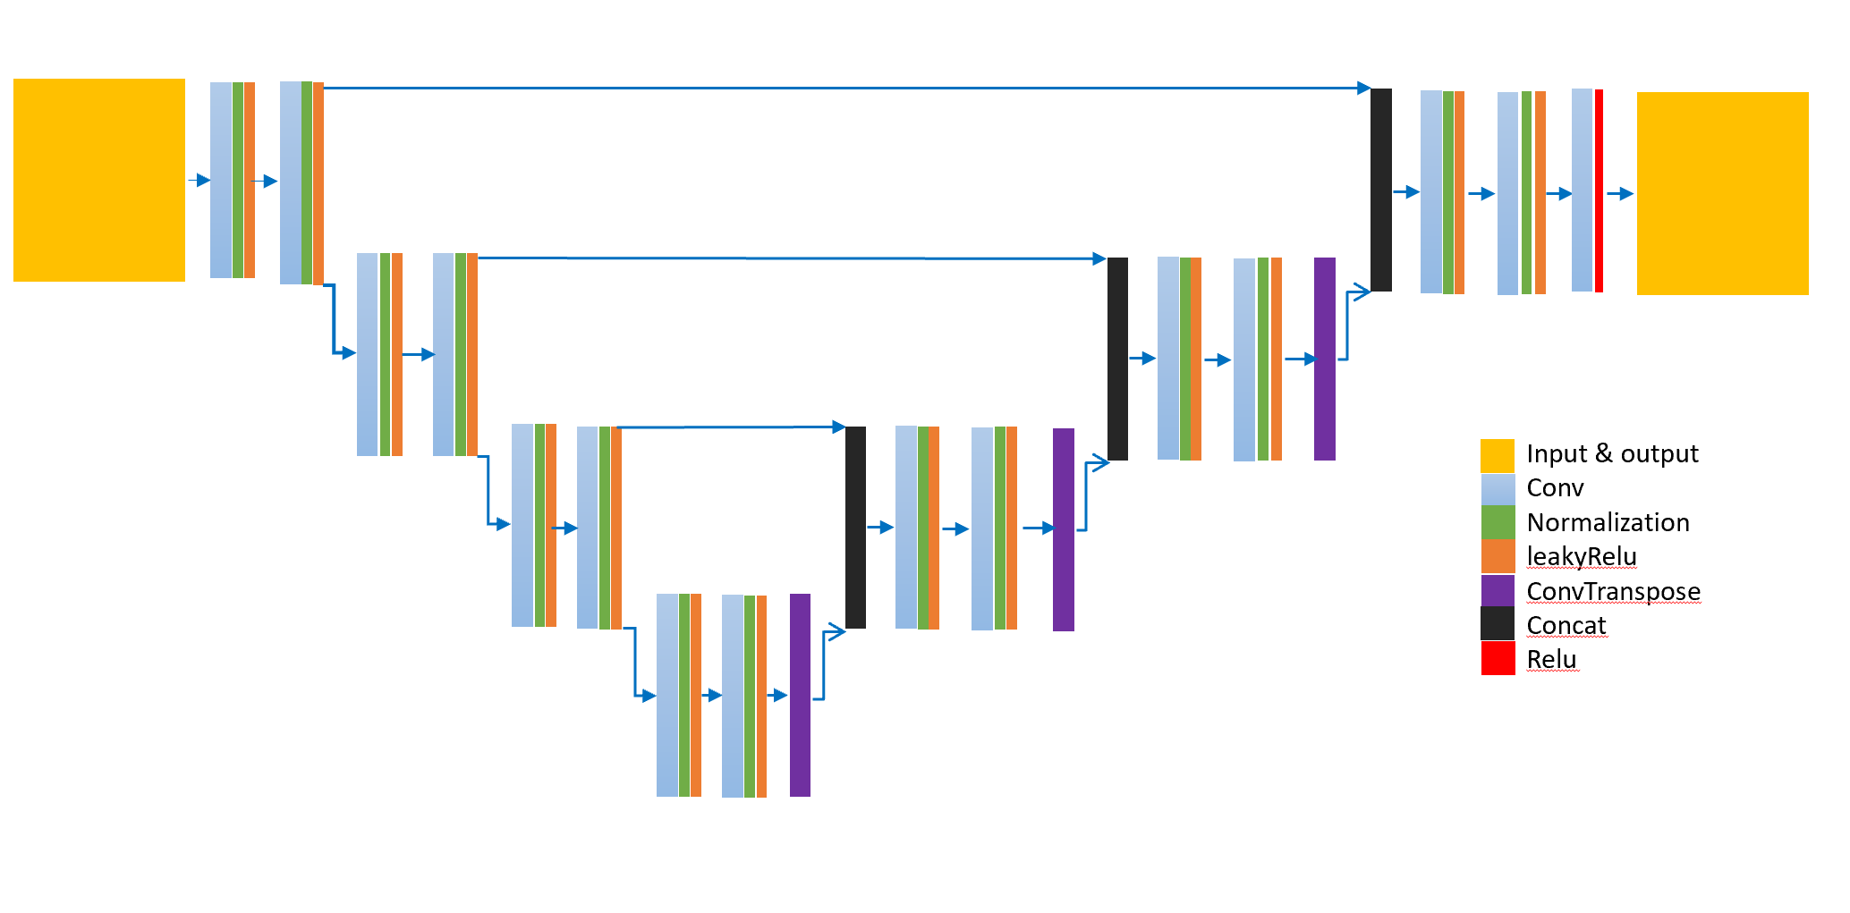
Hyper parameters
Dyn-UNet architecture
3D patches sized 168×168×16
20 patches per patient
Loss function of the mean squared error (MSE)
Learning rate of 0.001
Optimization Adam algorithm
Batch size: 4
spacing : [4.07, 4.07, 3.00]
four layers: [16, 32, 64, 128]
Kernels: [3, 3, 3]
2 super vision head
The architecture of DynUnet
Notes:
We used unet artitecture. 20 patches of 168, 168 per 16 slices per each patient.
Spacing was picked based on the most frequent spatial resolution of the image.
Batch size based on available resources
Depth of mothel and kernel size was chosen ???
I used monai library
which refers to a robust and self-adapting framework on the basis of 2D and 3D vanilla U-Nets nnU-Net, a deep learning framework that condenses the current domain knowledge and autonomously takes the key decisions required to transfer a basic architecture to different datasets and segmentation tasks. Without manual tuning
The function computes the kernel sizes and strides required at each layer of the network to achieve this downsampling, taking into account the original size and spacing of the input data.
def get_kernels_strides(patch_size, spacing): appears to be designed for determining the appropriate kernel sizes and strides
If True, in training mode, the forward function will output not only the final feature map (from output_block), but also the feature maps that come from the intermediate up sample layers.

Slide 17
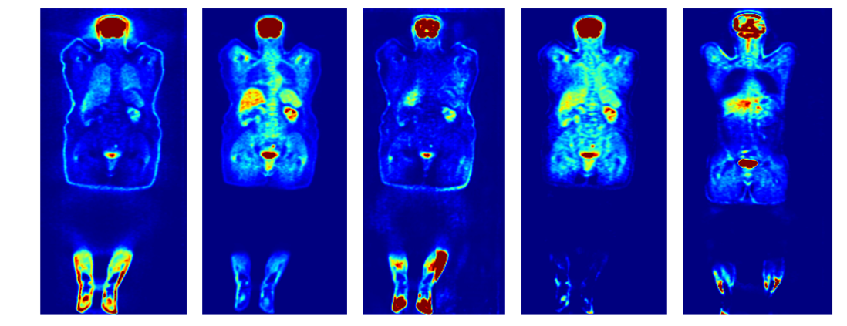
DL Models
NAC MAC IMCM TL - MC ADCM
⁶⁸Ga-PET
IMCM
ADCM
¹⁸F-FDG
TL-MC
ADCM
IMCM → Integrated multi-Centre model ADCM → Anatomy-Dependent Correction Model TL-MC → Transfer Learning for IMCM model
Notes:
Maximum Intensity Projection (MIP)
Transfer Learning for IMCM model (TL-MC):
For cross center evaluation we train our network on Ga dataset and we named it IMCM.
We also tried ADCM model on this dataset.
For cross tracer essessment, we tuned IMCM on fdg dataset and named it TL-MC.
As we discuse ADCM was also tested on the fdg dataset without any tuning or changing in the waites of the model.

Slide 18
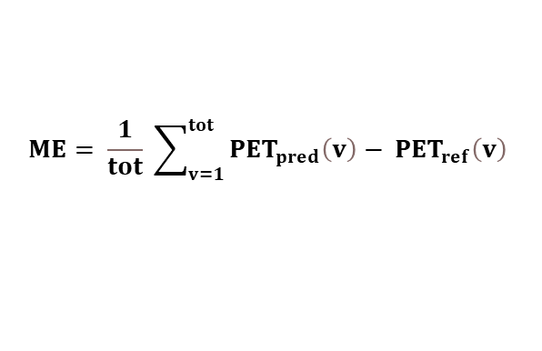
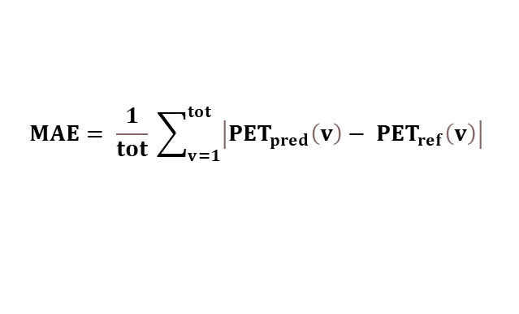
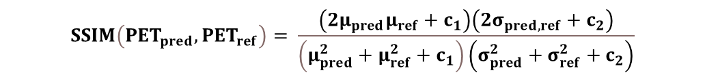
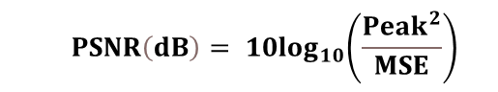
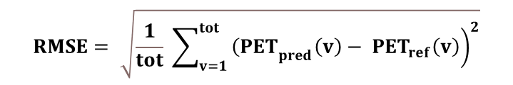
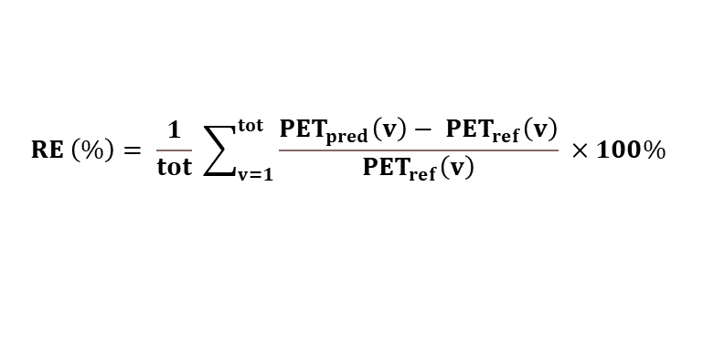
Quantitative analysis
$$ME= \frac{1}{tot} \sum_{v=1}^{tot}{{PET}_{pred}\left(v\right)− {PET}_{ref}\left(v\right) }$$
$$MAE= \frac{1}{tot} \sum_{v=1}^{tot}{\left|{PET}_{pred}\left(v\right)− {PET}_{ref}\left(v\right)\right| }$$
$$RE \left(\%\right)= \frac{1}{tot} \sum_{v=1}^{tot}{\frac{{PET}_{pred}\left(v\right)− {PET}_{ref}\left(v\right)}{{PET}_{ref}\left(v\right)} ×100\% }$$
$$RMSE= \sqrt{\frac{1}{tot} \sum_{v=1}^{tot}{{\left.{\left(PET\right.}_{pred}\left(v\right)− {PET}_{ref}\left(v\right)\right)}^{2}}}$$
$${ PSNR\left(dB\right)= 10log}_{10}\left(\frac{{Peak}^{2}}{MSE}\right)$$
$$SSIM\left({PET}_{pred},{PET}_{ref}\right)= \frac{\left(2μ_{pred}μ_{ref}+c_{1}\right)\left(2σ_{pred,ref}+c_{2}\right)}{\left(μ_{pred}^{2}+μ_{ref}^{2}+c_{1}\right)\left(σ_{pred}^{2}+σ_{ref}^{2}+c_{2}\right)}$$
Notes:
The performance of the trained network in dl pet images is evaluated
Using these various metrics that compare the model’s outcome to the reference
from the same patient.
The metrics we use were:
Mean Error (ME), Mean Absolute Error (MAE): is the average of the absolute differences between predicted and reference values
Relative Error (RE%): Root Mean Squared Error (RMSE):
Peak Signal-to-Noise Ratio (PSNR):
measures the ratio between the maximum possible value and the magnitude of the error, providing an indication of the overall quality of the predictions relative to the reference.
structural similarity
SSIM evaluates the structural similarity between the predicted and reference images, focusing on perceptual quality rather than just pixel differences
index has a scale between −1 to 1, where an SSIM
1 represents a perfect recovery of the original image..
------------------------
Mean Error, Mean Error (ME):
Represents the average difference between predicted and reference values
Mean Absolute Error (MAE):
This is the average of the absolute differences between predicted and reference values, giving a sense of overall prediction accuracy without considering the direction of the error.
Relative Error (RE%):
Shows the error as a percentage of the reference value, providing a normalized way to compare errors across different scales.
Root Mean Squared Error (RMSE):
RMSE is a measure of the square root of the average squared difference between the
Two pet images for each voxel : has the usit as same as the imge, so it is suv.
Combines both the magnitude and variance of the errors, penalizing larger errors more than smaller ones. It's particularly useful for highlighting large deviations in predictions.
Peak Signal-to-Noise Ratio (PSNR):
measures the ratio between the maximum possible value and the magnitude of the error, providing an indication of the overall quality of the predictions relative to the reference.
PSNR is a measure of relative power of the relative difference or noise in an image
compared to its reference
structural similarity
SSIM evaluates the structural similarity between the predicted and reference images, focusing on perceptual quality rather than just pixel differences
index has a scale between −1 to 1, where an SSIM
1 represents a perfect recovery of the original image..
-----------------------------------------------
MAE is similar to the RMSE except that it is the absolute error rather than the squared error
as calculated using the following equation
MAE also yields error in units that match the original image
. One limitation of the MAE
approach is that if errors are centered around zero, the values of MAE may be much smaller
than RMSE. Both RMSE and MAE can be sensitive to the cropping of the images: if images
contain large amounts of surrounding air, this can have the effect of decreasing the average
error, as models can often predict surrounding air with near perfect accuracy.

Slide 19
Results

Slide 20
⁶⁸Ga-PET
Notes:
IMCM represent lower mean errors compared to ADCM for all 4 error matrics both in external and internal test set.
Both models show higher errors in deal with external center, but ADCM has a slightly higher MAE and RMSE with a larger spread.
SSIM Also, IMCM achieves higher SSIM, showing better image quality.
Overall, IMCM outperforms ADCM in most metrics, providing more reliable and higher quality images.

Slide 21
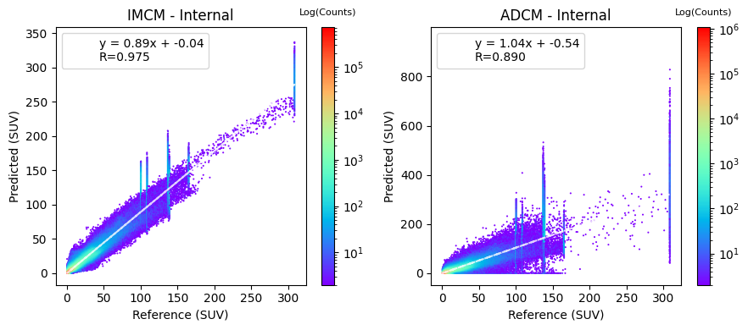
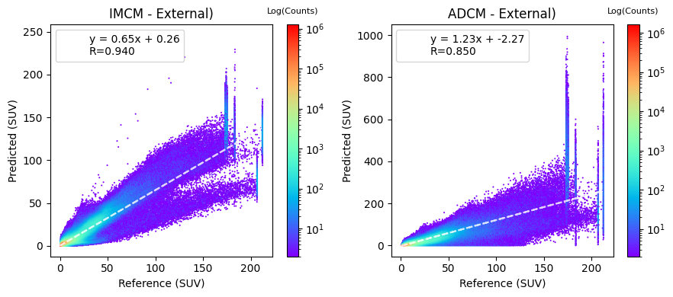
⁶⁸Ga-PET
Notes:
The joint histogram shows the voxel-wise correlation for predicted values compared to the reference ones.
Top left: This panel shows the comparison for the IMCM model within internal centers. The slope is (0.89), the intercept is close to 0.
The R-value (0.975) suggests strong linear relationship between predicted and reference values.
indicating that the model predicts values close to the reference, but with slight underestimation
IMCM - External (Bottom Left):
This panel shows the comparison for the IMCM model within external centers (C5).
The slope (0.65) is less than 1, indicating significant underestimation of predicted values compared to the reference.
The intercept (0.26) shows a slight positive bias.
The R-value (0.940) suggests a good linear relationship but weaker compared to internal cases.
ADCM - Internal (Top Right):
The slope (1.04) is slightly greater than 1, indicating a slight overestimation by the model.
The intercept (0.54) suggests a minor positive bias.
The R-value (0.890) is lower than that of IMCM, indicating a weaker linear relationship.
ADCM - External (Bottom Right):
The slope (1.23) is much greater than 1, indicating a notable overestimation of predicted values.
The intercept (-2.27) indicates a negative bias.
The R-value (0.850) is the lowest among all panels, indicating the weakest linear relationship.
General Observations:
IMCM generally shows less deviation from the reference values compared to ADCM, both in internal and external cases.
ADCM tends to overestimate SUV values more than IMCM, especially in external centers.
-------------------------------------------------
General Observations:
Both models (IMCM and ADCM) perform better (closer to the ideal line) in internal centers compared to external centers.
The differences between predicted and reference values are more pronounced in the external centers, with ADCM showing greater deviation compared to IMCM.
IMCM vs. ADCM:
IMCM generally shows less deviation from the reference values compared to ADCM, both in internal and external cases.
ADCM tends to overestimate SUV values more than IMCM, especially in external centers.
The plots suggest that the IMCM model performs more reliably across both internal and external centers compared to the ADCM model, which shows more significant deviations, especially in external cases. The color intensity distribution indicates where most of the data points are concentrated, helping visualize the density of SUV predictions relative to the reference values.

Slide 22
¹⁸F-FDG
Notes:
In cross trqcer validation
Accuracy (Mean Error & Mean Absolute Error):
TL-MC generally shows lower and more consistent errors compared to ADCM, indicating it provides more accurate SUV predictions across different scenarios.
Precision (Relative Error & RMSE):
TL-MC exhibits lower relative error and RMSE, suggesting it is more precise in its predictions, with less variability compared to ADCM.
Image Quality (PSNR & SSIM):
ADCM shows more stability and constant parameters regarding TL-MC.
Overall Conclusion:
TL-MC consistently performs better than ADCM in terms of accuracy, precision, and image quality, making it the more reliable model across different conditions. ADCM tends to show higher variability and errors, indicating it may struggle more in certain scenarios.
-----------------------------
For ME, ADCM shows overestimated and TLMC shows understination,
For RE, RMSE TLMC shows lower values.
About P

Slide 23
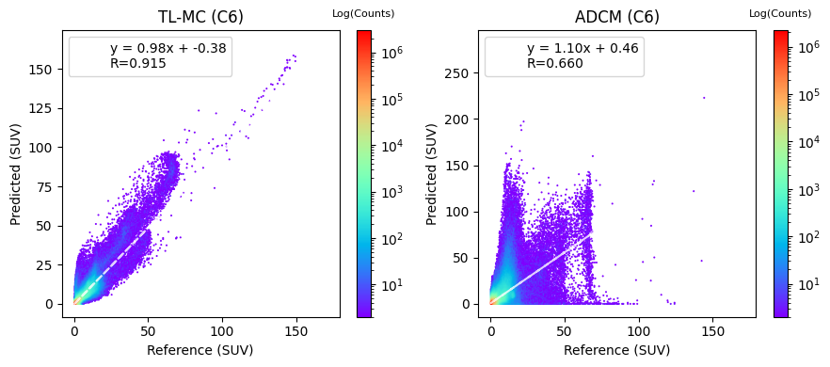
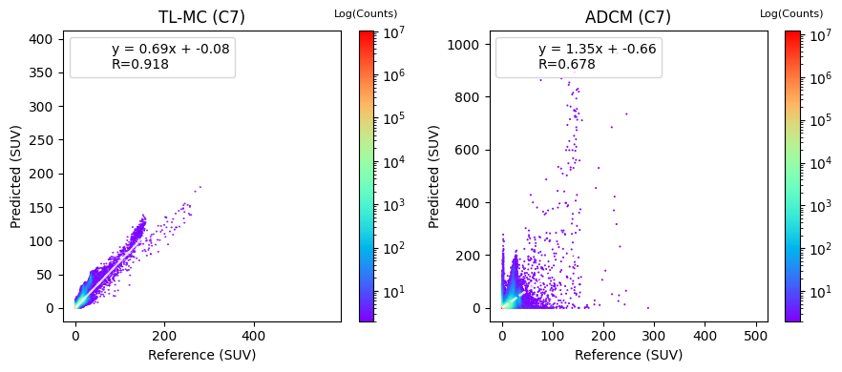
¹⁸F-FDG
Notes:
The TL-MC shows better performance across both centers compared to the ADCM model.
This is proved by higher correlation coefficients and R values.
while the TL-MC model’s predictions are more reliable, especially for lower SUVs.
the ADCM model shows noticeable variability and tends to overestimate SUVs,
particularly in the higher range,

Slide 24
Artifact Detection & Correction

Slide 25
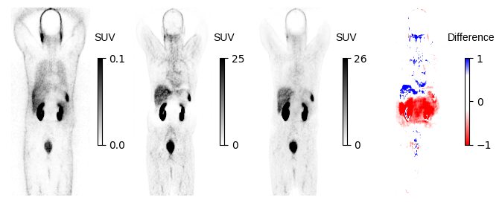
Halo artifact in kidney

Slide 26
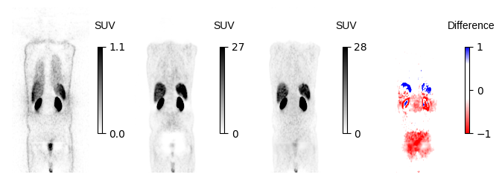
Halo artifact

Slide 27
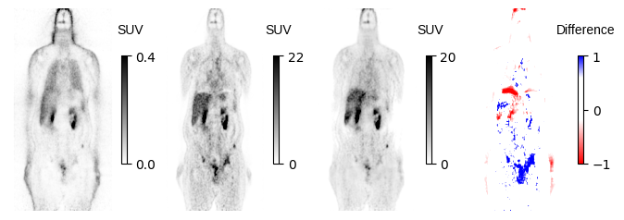
Motion Artifact

Slide 28
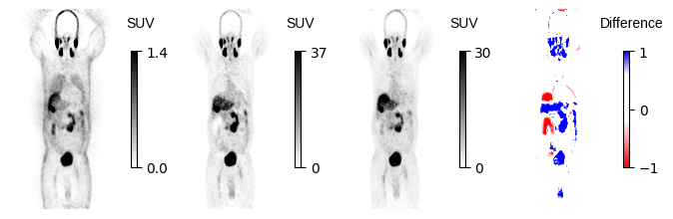
Motion & Halo Artifact

Slide 29
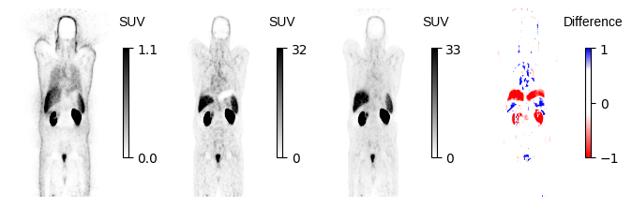
Motion artifact

Slide 30
Auto – Dashboard for ASC
Click on DL ASC PET App
Notes:
I have developed a dashboard that enables real-time attenuation and scatter correction (ASC) .
The dashboard allows users to process data instantly and assess the effectiveness of the model on the fly

Slide 31
Discussion
🗨️ Developed a CT-free DL models for ASC in PET imaging,
🗨️ Tested across different centers and radiotracers.
🗨️ For cross-center data, IMCM outperformed ADCM.
🗨️ Regarding cross-tracer data, TL-MC obviously follows the regression line.
Notes:
So in this research, we Developed two CT-free DL models for ASC in PET imaging,
We tested models in face with different centers and radiotracers.
In cross center evaluation, we saw IMCM outperformed ADCM, it demonstrated less error and higher similarity to the reference image.
Internal Data: IMCM consistently outperforms ADCM across all metrics, demonstrating better accuracy and image quality.External Data: Both models struggle, but ADCM’s performance drops more significantly, particularly in maintaining image quality, as indicated by the larger errors and lower PSNR and SSIM values.
In Face with cross-center data, tuned version of IMCM resulted in MAE and RMSE value shows smaller error in comparison to ADCM.
While ADCM performed more stable with less fluctuation in PSNR and SSIM in response to different centers.
in joint histogram evaluation, TL-MC obviously follows the regression line better than ADCM.
ADCM did not show good performance to predict suvs relible.
The color intensity distribution indicates where most of the data points are concentrated, helping visualize the density of SUV predictions relative to the reference values.
---------------------------------------
Conclusion:
The plots suggest that the IMCM model performs more reliably across both internal and external centers compared to the ADCM model, which shows more significant deviations, especially in external cases. The color intensity distribution indicates where most of the data points are concentrated, helping visualize the density of SUV predictions relative to the reference values.
In joint histogram: While the TL-MC model performs consistently across centers, the ADCM model shows noticeable differences, particularly struggling more with accurate predictions at C7 compared to C6.

Slide 32
DL-ASC Enhances PET Image Quality
IMCM vs. ADCM: Performance Comparison
Improving ASC Accuracy with Multi-Center Data
Limitations of ADCM in Handling Variability
Challenges with Universal ADCM Models
Joint Histogram Analysis of ADCM
TL-MC: Consistent SUV Estimations
CT-Based Corrections and 68Ga PET Imaging
Single-Center Dataset Limitations
Future Research: Clinical Imaging Parameters
IMCM Performance in Organ-Specific Evaluations
Notes:
1- Our findings indicate that DL-ASC enhances both quantitative and qualitative aspects of PET images and effectively identifies and corrects mismatches and halo artifacts without needing anatomical images.
2- The IMCM demonstrated better performance in terms of lower error metrics and higher similarity index compared to ADCM in dealing with external centers.
3- In our research, we utilized different data from various hospitals, which enhanced the accuracy of ASC in PET images when implementing a shared model across different hospitals for identical radiotracer imaging.
4- While the ADCM method focuses on decomposing the PET image correction process, our investigation couldn’t prove that this method is able to handle the differences between variant scanners and radiotracers well.
5- The ADCM output has demonstrated that a single universal model may not be effective due to variations in tracer-injected activity across different hospitals.
6- The joint histogram analysis raised questions regarding the calibration and reliability of the ADCM method in clinical situations.
7- Despite lower regression slopes, the TL-MC model demonstrates a more reliable and consistent performance in capturing the true behavior of SUVs across the studied centers.

Slide 33
Limitations
🧱 Challenged to preserve quantification characteristic of ADCM images,
due to facing with high value.
🧱Single universal models may not be effective;
radioisotope-specific tuning is necessary.
🧱 Limited access to computational resources
caused time consuming each training loop.
Notes:
We faced a few challenges during our work on this project:
In this project, we encountered a few key challenges:
Preserving the quantification characteristics of ADCM images was tricky, especially when dealing with high values. It required extra care to maintain the accuracy of the data.
Using a single universal model in this context? Not so effective. We found that radioisotope-specific tuning is really necessary to get the best results.
Each radiotracer needs specific tuning to get the best results. A universal model just doesn’t cut it.
On top of that, limited access to computational servers made our training loops take forever. So yeah, time-consuming was a big issue here.

Slide 34
📍 Train and test the model for more data from other centers.
📍 Assess the model organ-wise.
📍 Explore more Clinical Imaging Parameters.
📍 Targeted analysis for artifactual images.
📍 Rigorous statistical testing of categorized outcomes.
📍 Investigate other Neural Networks.
📍 Explore more other hyper-parameters.
Future Work
Notes:
"So, here’s what we’re thinking about for the next steps:
First off, we want to expand our training and testing by including more data from other centers. This will help us ensure that the model generalizes well across different settings.
Assessing the model organ-wise is another big priority. By looking at how well it performs on different organs, we can tailor it more specifically to clinical needs.
We’re also planning to dive deeper into clinical imaging parameters. Exploring these could reveal new ways to optimize the model’s performance.
Another key area is targeted analysis for artifactual images. We need to make sure the model handles those tricky cases where artifacts are present.
Rigorous statistical testing will be crucial for validating our categorized outcomes, making sure they’re solid.
We’re also interested in investigating other types of neural networks to see if there’s something out there that could do an even better job.
Lastly, exploring other hyper-parameters will be essential. Tuning these could further enhance the model’s performance."

Slide 35
🔍 Designed a network to directly performs ASC from raw data.
minimizing vulnerabilities related to pseudo-CT synthesis challenges.
🔍 Preformed well in different centers.
making it reliable and flexible for use in clinics.
🔍 Addressed artifact challenges effectively.
showcasing a high capability in detecting and removing artifacts in PET scans
🔍 Constructed a quality control method
to not only detect but to also overcome those artifacts.
🔍 Applicable where only Stand-alone PET
or PET/MRI systems are available.
🔍 Reduced in the cumulative radiation dose
would be valuable, particularly the paediatrics population
Conclusion
Notes:
“So, let's talk about what we've accomplished here.
🔍 First, we designed a network that directly handles attenuation and scatter correction (ASC) right from the raw PET data. This approach is great because it avoids the common pitfalls associated with generating pseudo-CT images, which can sometimes lead to errors.
🔍 The models we developed have been tested across multiple centers and with different radiotracers. They’ve performed well, proving themselves to be both reliable and flexible for clinical use. This is a big win for ensuring these models can be used widely in practice.
🔍 One of the major achievements is how effectively our models tackle the artifact challenges. They’re not just good at detecting artifacts in PET scans, but they’re also capable of removing them. This means cleaner, more accurate images for diagnosis.
🔍 We didn’t stop at just detection. We went a step further by constructing a method that not only spots these artifacts but also overcomes them. This adds an extra layer of assurance when using these models in real-world settings.
🔍 What’s really exciting is that these models can be applied in environments where only stand-alone PET or PET/MRI systems are available. This broadens their usability, especially in clinics that might not have access to the full range of imaging equipment.
🔍 Another important point is the reduction in cumulative radiation dose. This is particularly valuable in pediatric settings, where minimizing radiation exposure is crucial for patient safety.
🔍 Finally, we found that a one-size-fits-all model doesn’t quite work when you have variations in how different hospitals handle things like tracer activity, equipment, and image reconstruction. This reinforces the need for models that can be tuned specifically to the conditions of each hospital to ensure consistent accuracy and reliability."

Slide 36
References
[1] Shiri I, Salimi Y, Hervier E, Pezzoni A, Sanaat A, Mostafaei S, et al. Artificial Intelligence-Driven Single-Shot PET Image Artifact Detection and Disentanglement: Toward Routine Clinical Image Quality Assurance. Clin Nucl Med. 2023 Dec 1;48(12):1035–46
[2] McMillan, A. B., & Bradshaw, T. J. (2021). Artificial Intelligence-Based Data Corrections for Attenuation and Scatter in Position Emission Tomography and Single-Photon Emission Computed Tomography. PET clinics, 16(4), 543–552.
[3] Guo R, Xue S, Hu J, Sari H, Mingels C, Zeimpekis K, et al. Using domain knowledge for robust and generalizable deep learning-based CT-free PET attenuation and scatter correction. Nat Commun. 2022 Dec 1;13(1). [4] Shiri I, Salimi Y, Maghsudi M, Jenabi E, Harsini S, Razeghi B, et al. Differential privacy preserved federated transfer learning for multi-institutional 68Ga-PET image artefact detection and disentanglement. Eur J Nucl Med Mol Imaging. 2023;

Slide 37


Slide 38
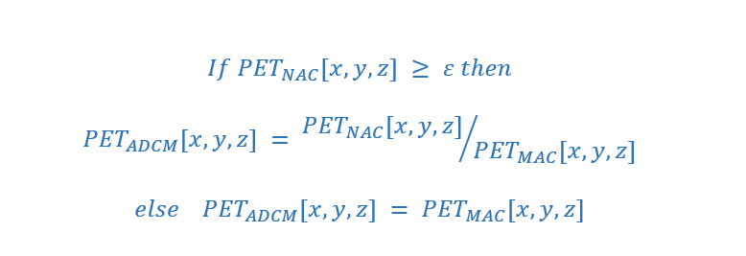
Workflow of Decomposition-Based Approach [1]
NAC (Input)
MAC (Target)
Anatomy-Dependent Correction Maps (ADCM)
Model Training
Anatomy-independent textures
DL PET
[3] Guo, Nat Commun. 2022

Slide 39
Workflow of Decomposition-Based Approach [1]
NAC (Input)
ADCM
Anatomy-Dependent Correction Maps (ADCM)
Model Training
Anatomy-independent textures
DL PET
[3] Guo, Nat Commun. 2022

Slide 40
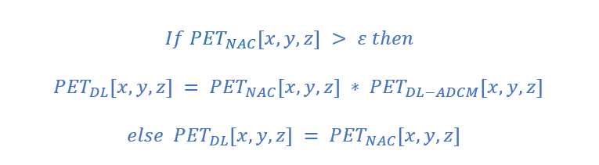
Workflow of Decomposition-Based Approach [1]
NAC (Input)
ADCM
Model Training
DL ADCM
DL PET
[2] Guo, Nat Commun. 2022

Slide 41
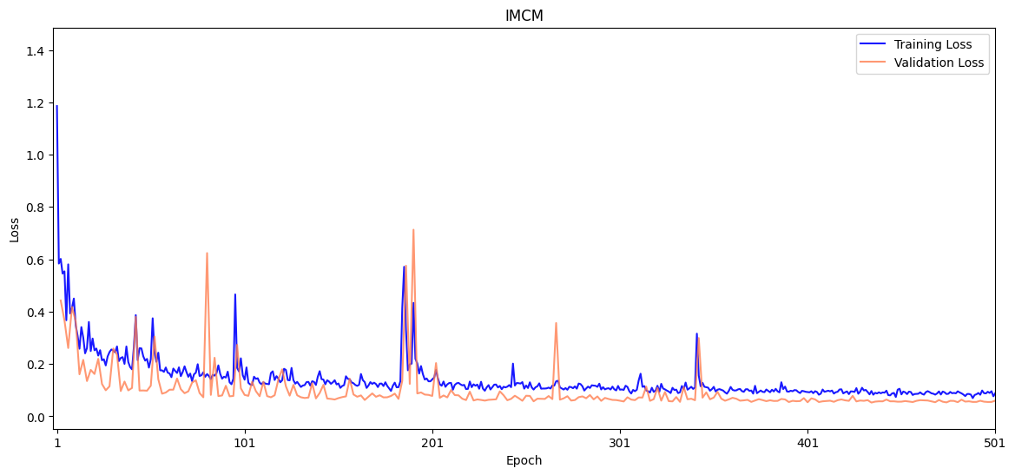
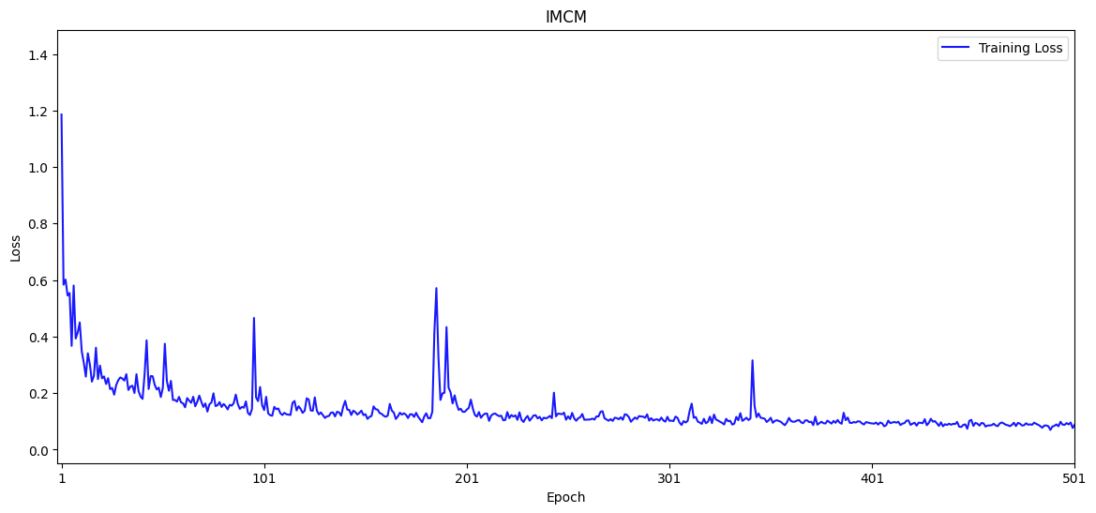
⁶⁸Ga-PET
Integrated multi-Centre model (IMCM): the best metric of 0.0527 at epoch 434.

Slide 42
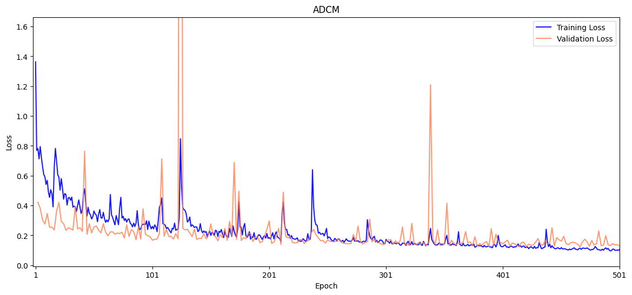
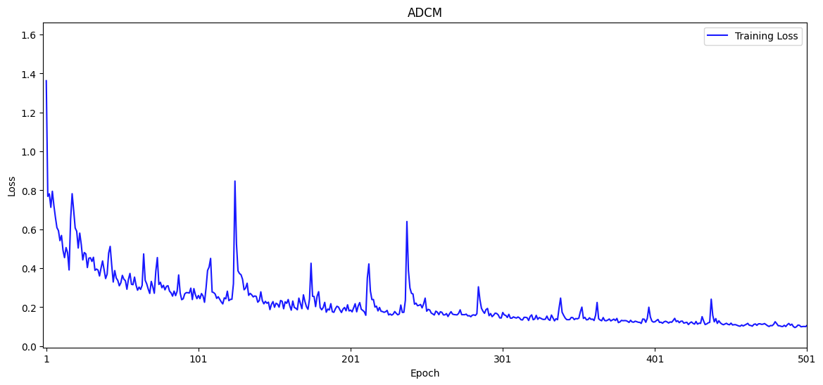
⁶⁸Ga-PET
Anatomy-Dependent Correction Model (ADCM): the best metric of 0.1237 was reached at epoch 466.

Slide 43
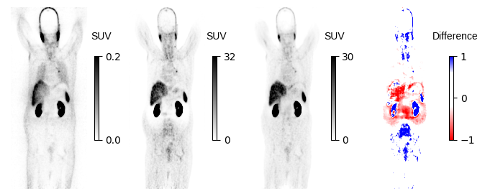
Motion and Halo

Slide 44
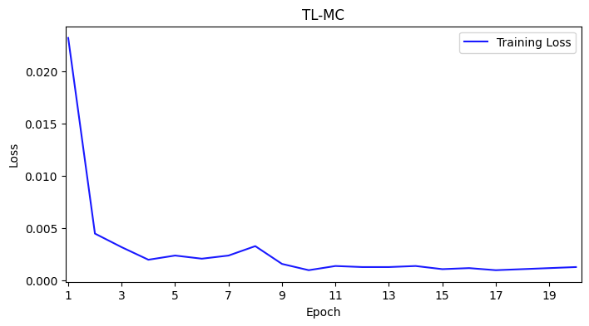
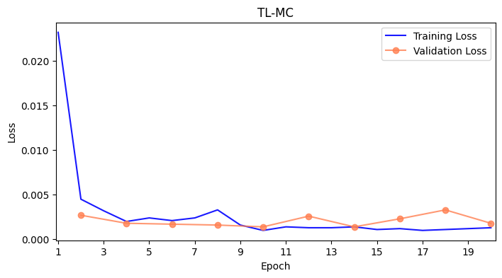
¹⁸F-FDG
Transfer Learning for IMCM model (TL-MC):

Slide 45
⁶⁸Ga-PET

Slide 46
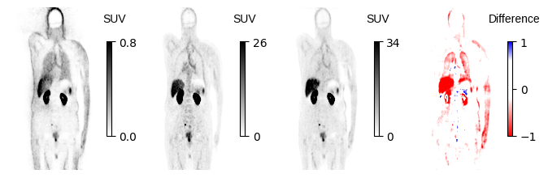
Truncation and Motion

Slide 47
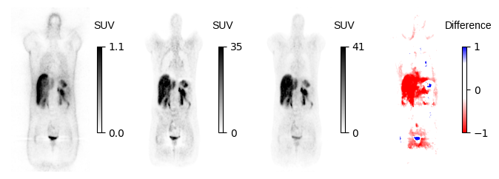
Halo

Slide 48
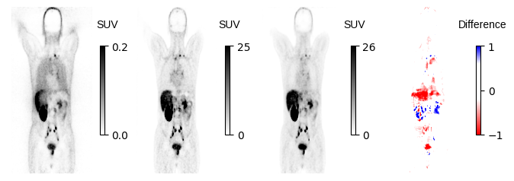
Motion Artifact

Slide 49
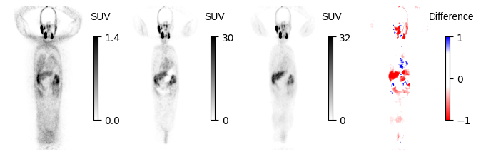
Metal artifact

Slide 50
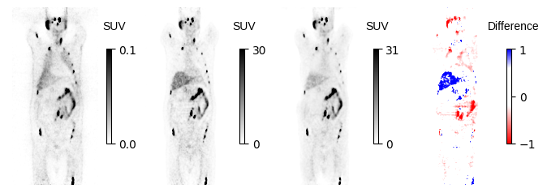
Motion Artifact???

Slide 51
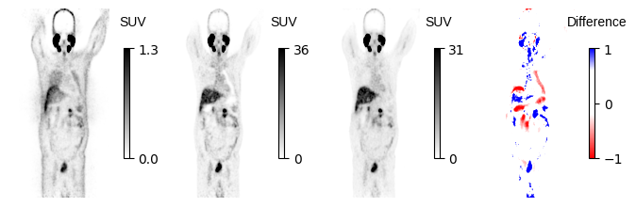
???

Slide 52



